Slide 1
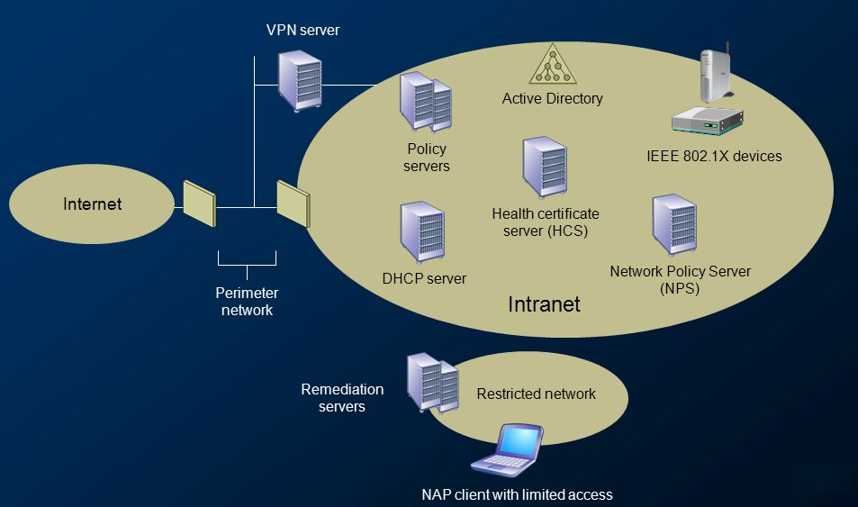
Advanced authentication with 802.1X. Wireless networking concepts
Module 5
SoftUni Team
Technical Trainers
Software University
http://softuni.bg

Slide 2
Questions
sli.do #NetAdvanced

Slide 3
Table of Contents
Advanced authentication with 802.1X
Wireless networking concepts
Demonstration

Slide 4
Advanced authentication with 802.1X

Slide 5
AAA
AAA: Authentication, Authorization and Accounting
Authentication – “Who are you? Prove it!”
Authorization – “This is where you have access and where you do not”
Accounting – “I am recording all (un)successful login attempts”
Often a single server plays the three roles but can be multiple servers as well

Slide 6
802.1X
IEEE 802.1X is an IEEE Standard for Port-based Network Access Control (PNAC)
Part of the IEEE 802.1 group of networking protocols
Provides authentication mechanism to devices asking to attach to a LAN or a WLAN
Uses Extensible Authentication Protocol (EAP) over LAN – known as EAPOL

Slide 7
The participants in 802.1X
Supplicant - the end device requesting access
Authenticator – usually a switch or AP which is to provide access
Authentication Server - the device which makes the decision (grant/deny access). Usually RADIUS server

Slide 8
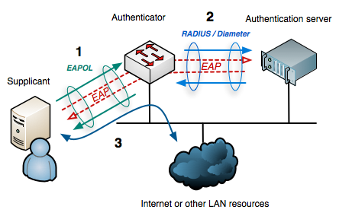
802.1X

Slide 9
Why 802.1X?
The switches and access points do not need to know how to authenticate the client
They (authenticators) simply pass the authentication information between the client and the authentication server
That is why it is easier for 802.1X to support many authentication methods

Slide 10
802.1X and EAP
802.1x uses EAP to facilitate the communications between the participants
Common EAP authentication types:
EAP-MD5 - minimal security, one-way authentication
EAP-TLS - mutual authentication, secure but no very easy to adopt
EAP-TTLS - mutual authentication (optional client certificate)
EAP-PEAP - most popular method, has an “outer” and “inner” methods, developed by Cisco, Microsoft and RSA Security

Slide 11
Network Access Protection

Slide 12
Questions
sli.do #NetAdvanced

Slide 13
Wireless networking concepts

Slide 14

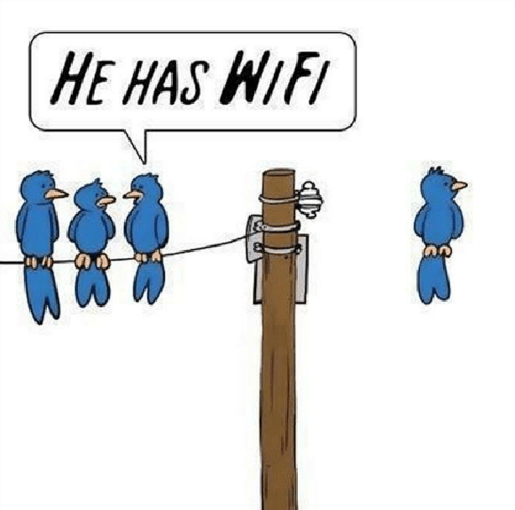
Cable vs Wireless?
Speed
Signal quality
Mobility
Device adaptability
Security
Interference

Slide 15
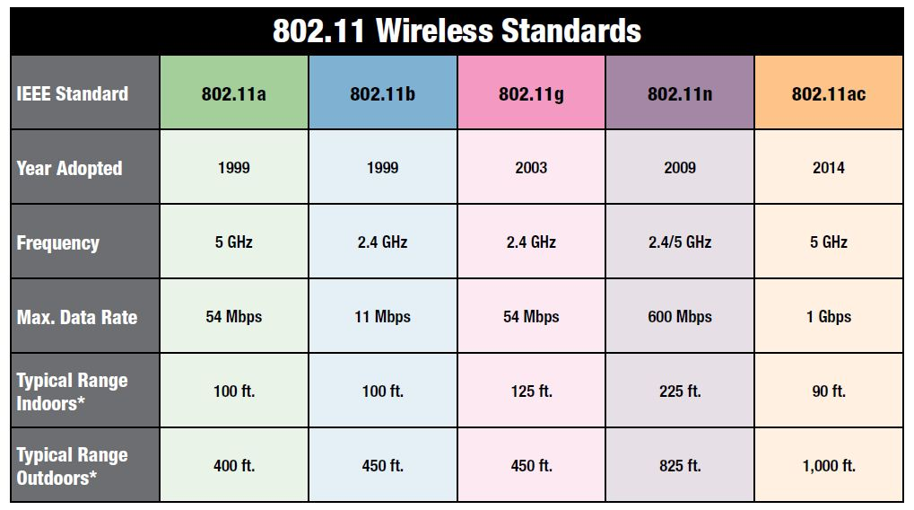
802.11 standards

Slide 16
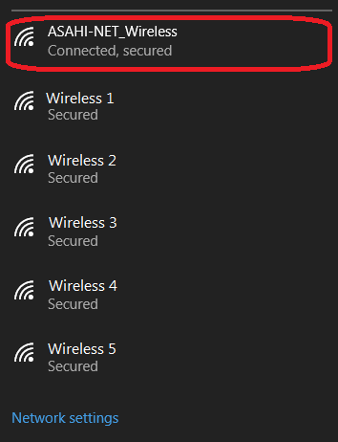
SSID
SSID: Service Set Identifier
This is the name of the wireless network (not the Access Point name)
It is up to 32 characters in length
A single AP can broadcast multiple SSIDs
Should you hide your SSID?

Slide 17
Wireless security
Hiding the SSID (“not the best” security)
MAC ID filtering
Static client IP addressing
802.11 security (next slide)

Slide 18
802.11 security
WEP – very weak, deprecated
WPA – better than WEP, still risky
WPA2 – the de facto standard
WPA2 (TKIP) - risky
WPA2 (AES)
WPA2-PSK vs WPA2-Enterprise (which uses EAP)

Slide 19
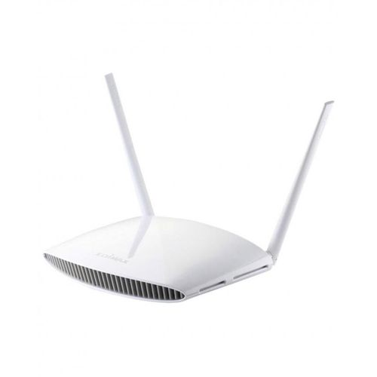
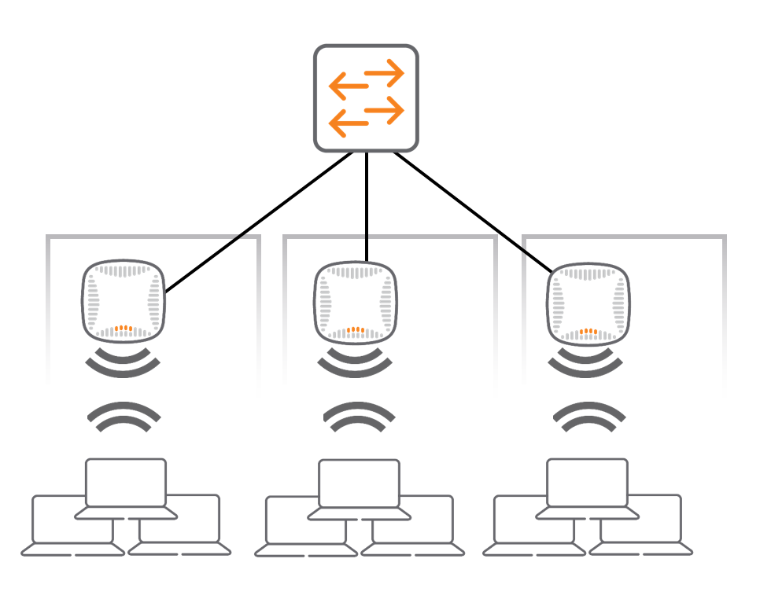
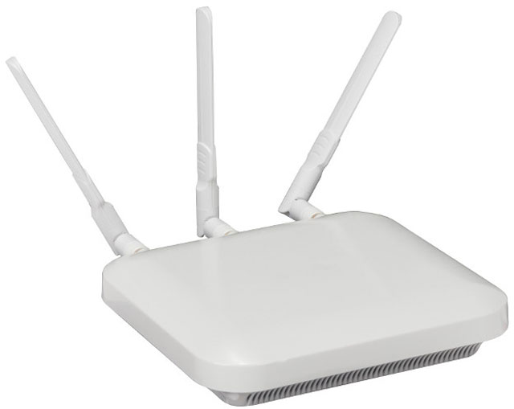
Wireless devices management
APs in standalone mode
APs controlled by a controller

Slide 20




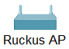
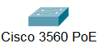
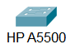




VLAN 5 (guest): 10.5.5.0/24
Internet
VLAN 10 (corporate): 10.10.10.0/24
Corporate WEB and DNS Server
SSID:
NetFund-Guest
SSID:
NetFund-Corporate
ge1/0/26
fe0/0/0
g0/1
g0/2
ge1/0/25
ge1/0/27
fe0/0/1
Fiber optic

Slide 21
Topology details
DHCP server for both VLANs is the Cisco device
Juniper is making NAT for both VLANs
Device, interface | IP address
Cisco, VLAN 5 | 10.5.5.1
Cisco, VLAN 10 | 10.10.10.1
HP, VLAN 5 | (10.5.5.10)
HP, VLAN 10 | (10.10.10.10)
Corporate server (Web and DNS) | 10.10.10.101
Juniper, VLAN 5 | 10.5.5.100
Juniper, VLAN 10 | 10.10.10.100

Slide 22
Questions
sli.do #NetAdvanced

Slide 23
Demonstration

Slide 24

Summary
Advanced authentication with 802.1X
Wireless networking concepts
Demonstration
…
…
…

Slide 26






СофтУни диамантени партньори

Slide 27






СофтУни диамантени партньори

Slide 28





Trainings @ Software University (SoftUni)
Software University – High-Quality Education, Profession and Job for Software Developers
softuni.bg
Software University Foundation
http://softuni.foundation/
Software University @ Facebook
facebook.com/SoftwareUniversity
Software University Forums
forum.softuni.bg

